Slide 1
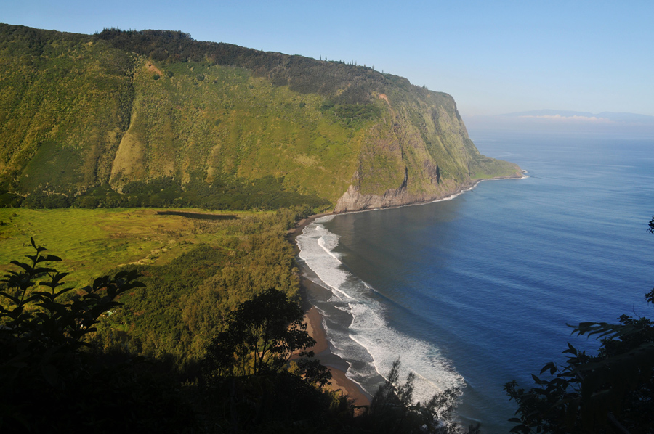
Waipio Valley
“The Valley of the Kings”

Slide 2
Kosei Travel USA
2013 Valley of the Kings
Kahea Design LLC
73-1749 Hao Street, kailua Kona Hawaii, 96740
Melvin G. Mason Jr (808) 987-3192 kaneuhanenui@gmail.com
Susanna Nordlund (808) 430-6657 nordlund.susanna@gmail.com
www.kaheadesign.com
Kahea Design LLC
All Rights Reserved
© 2012-2013

Slide 3
Vision Statement
We are an advocate bringing forth the Hawaiian Education of the Traditions and Culture through the Ancient Kupuna Knowledge and Wisdom!
Mission Statement
We support Waipio Valley by providing access to learning in an educational environment in the openness of nature, with a Cultural exploratory sense and outreach educational program organizationally housed in Ka Ha O Na Kupuna School of Ancient Hawaiian Knowledge and Wisdom of Hawaiian Wayfinding, Arts, Traditions and Culture. This is the Hawaiian spiritual actions and the preservation with perpetuation of Hawaiian language at Waipio Valley Education Center.

Slide 4
Cultural Values
Our Hawaiian cultural values stresses the importance of our natural elements. This is a way of Life in an environment that possesses the mana, a spiritual power that can be associated with mythological beings of understanding. Hawaiians’ relationship with the natural elements demonstrates how physical and spiritual our connections impact the sense of community that embraces the success and survival of Life. The Wai “Water” has always been and continues to be an important resource in our well-being. Our Hawaiian values are readily found in our oli “chants”, mele “music and stories.
Our oral traditions seek to illustrate our relationship between the Heavens and our Aina “Land”. It is a true form from a perspective that the traditional water allocation kuleana “responsibility” and ways of Life that we understood in Sacredness. Ahupuaʻa Kuleana understanding of our Ancestral past have served as a guideline for our Ancestral Future of Waipiʻo Valley today.

Slide 5
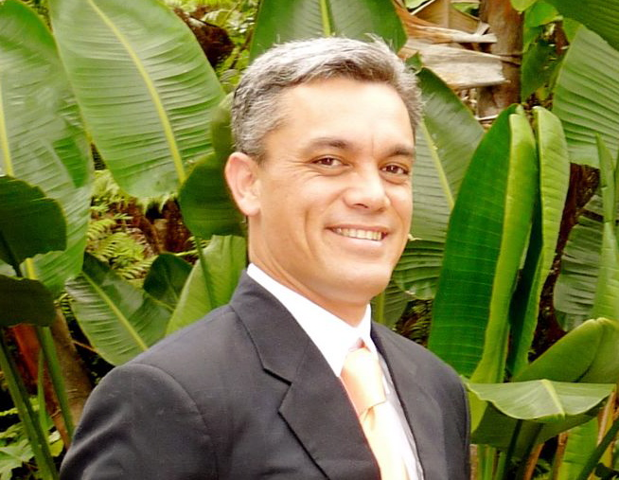
Coordinator - Melvin G. Mason Jr.
Phone: (808) 987 - 3192 Email: kaneuhanenui@gmail.com

Slide 6
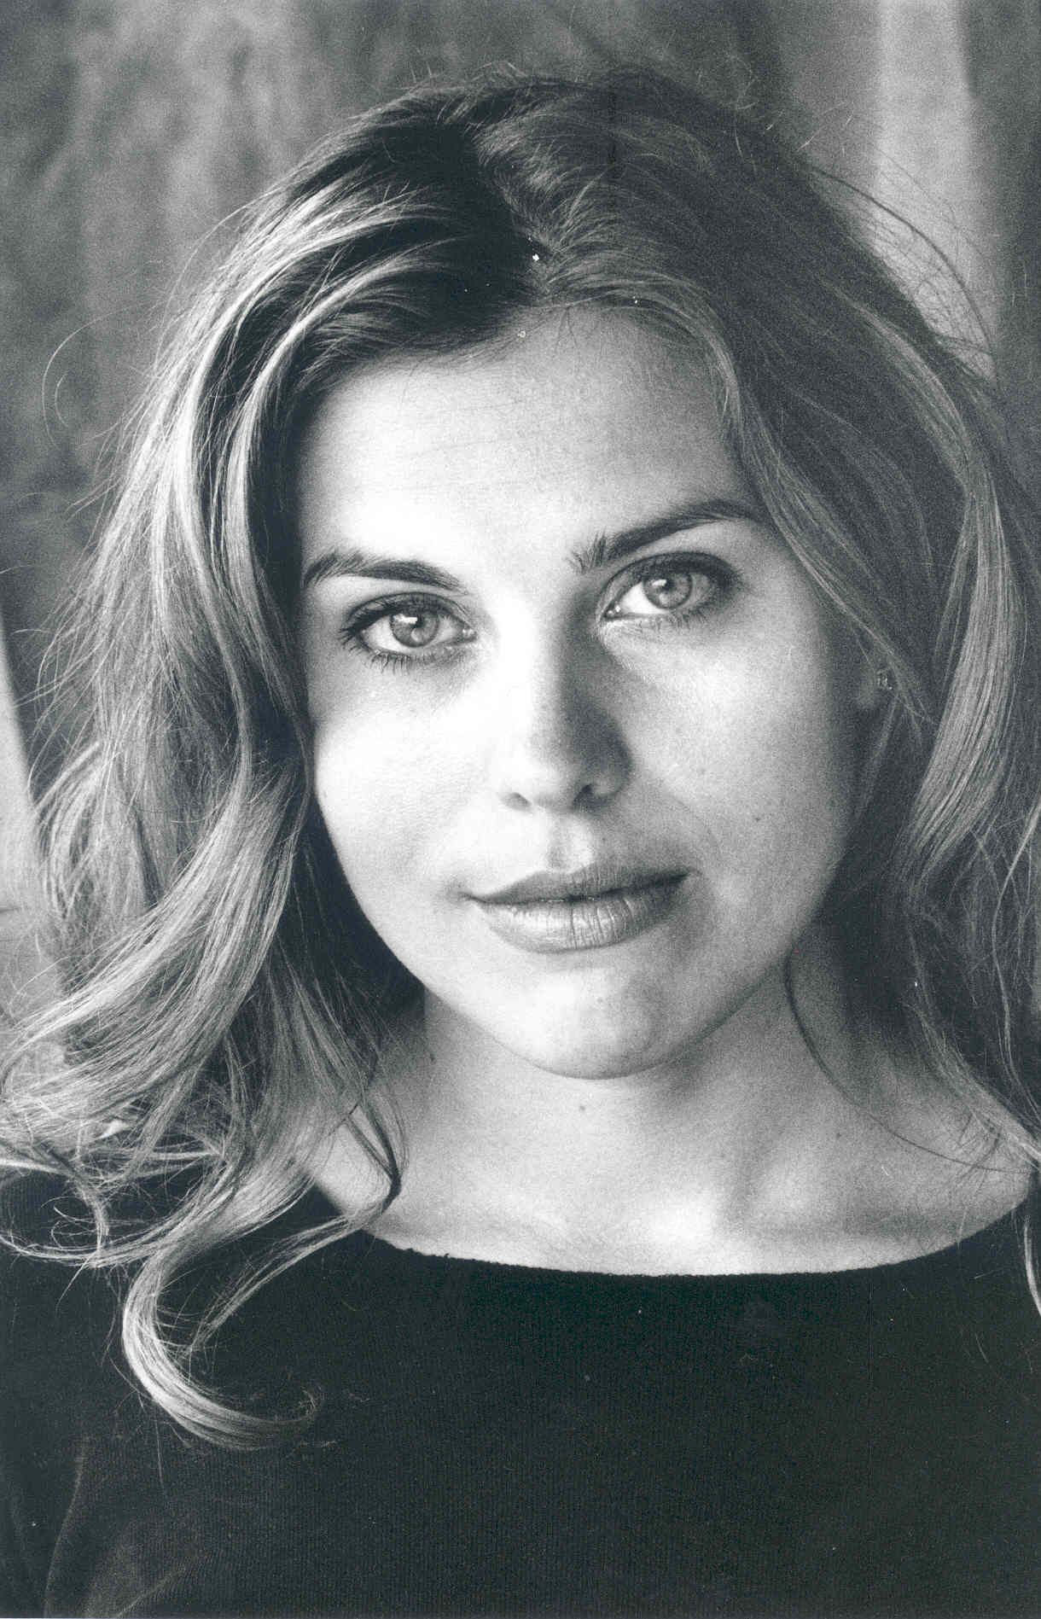
Coordinator - Susanna Nordlund
Phone: (808) 430 - 6657 Email: nordlund.susanna@gmail.com

Slide 7
A Unique Royal Hawaiian Experience
Our Valley Tours provide guests with an authentic Royal Hawaiian cultural experience in a pristine and tranquil setting with insightful tour guides.
In addition to our specialty tours with individual discernment, our retreat incorporates a healthy whole Hawaiian lifestyle of the Valleys Royal Family, which includes Hawaiiʻs most Sacred Puʻuhonua “Refuge” where the King Kamehameha of Hawaii have been Raised under the Protection of the Prophecy.
Guests will receive this Great Sacred Spiritual Lifestyle and understanding that has been kept in a protection within the Ancestral Descendants of the Kings and Queens Comfort!

Slide 8
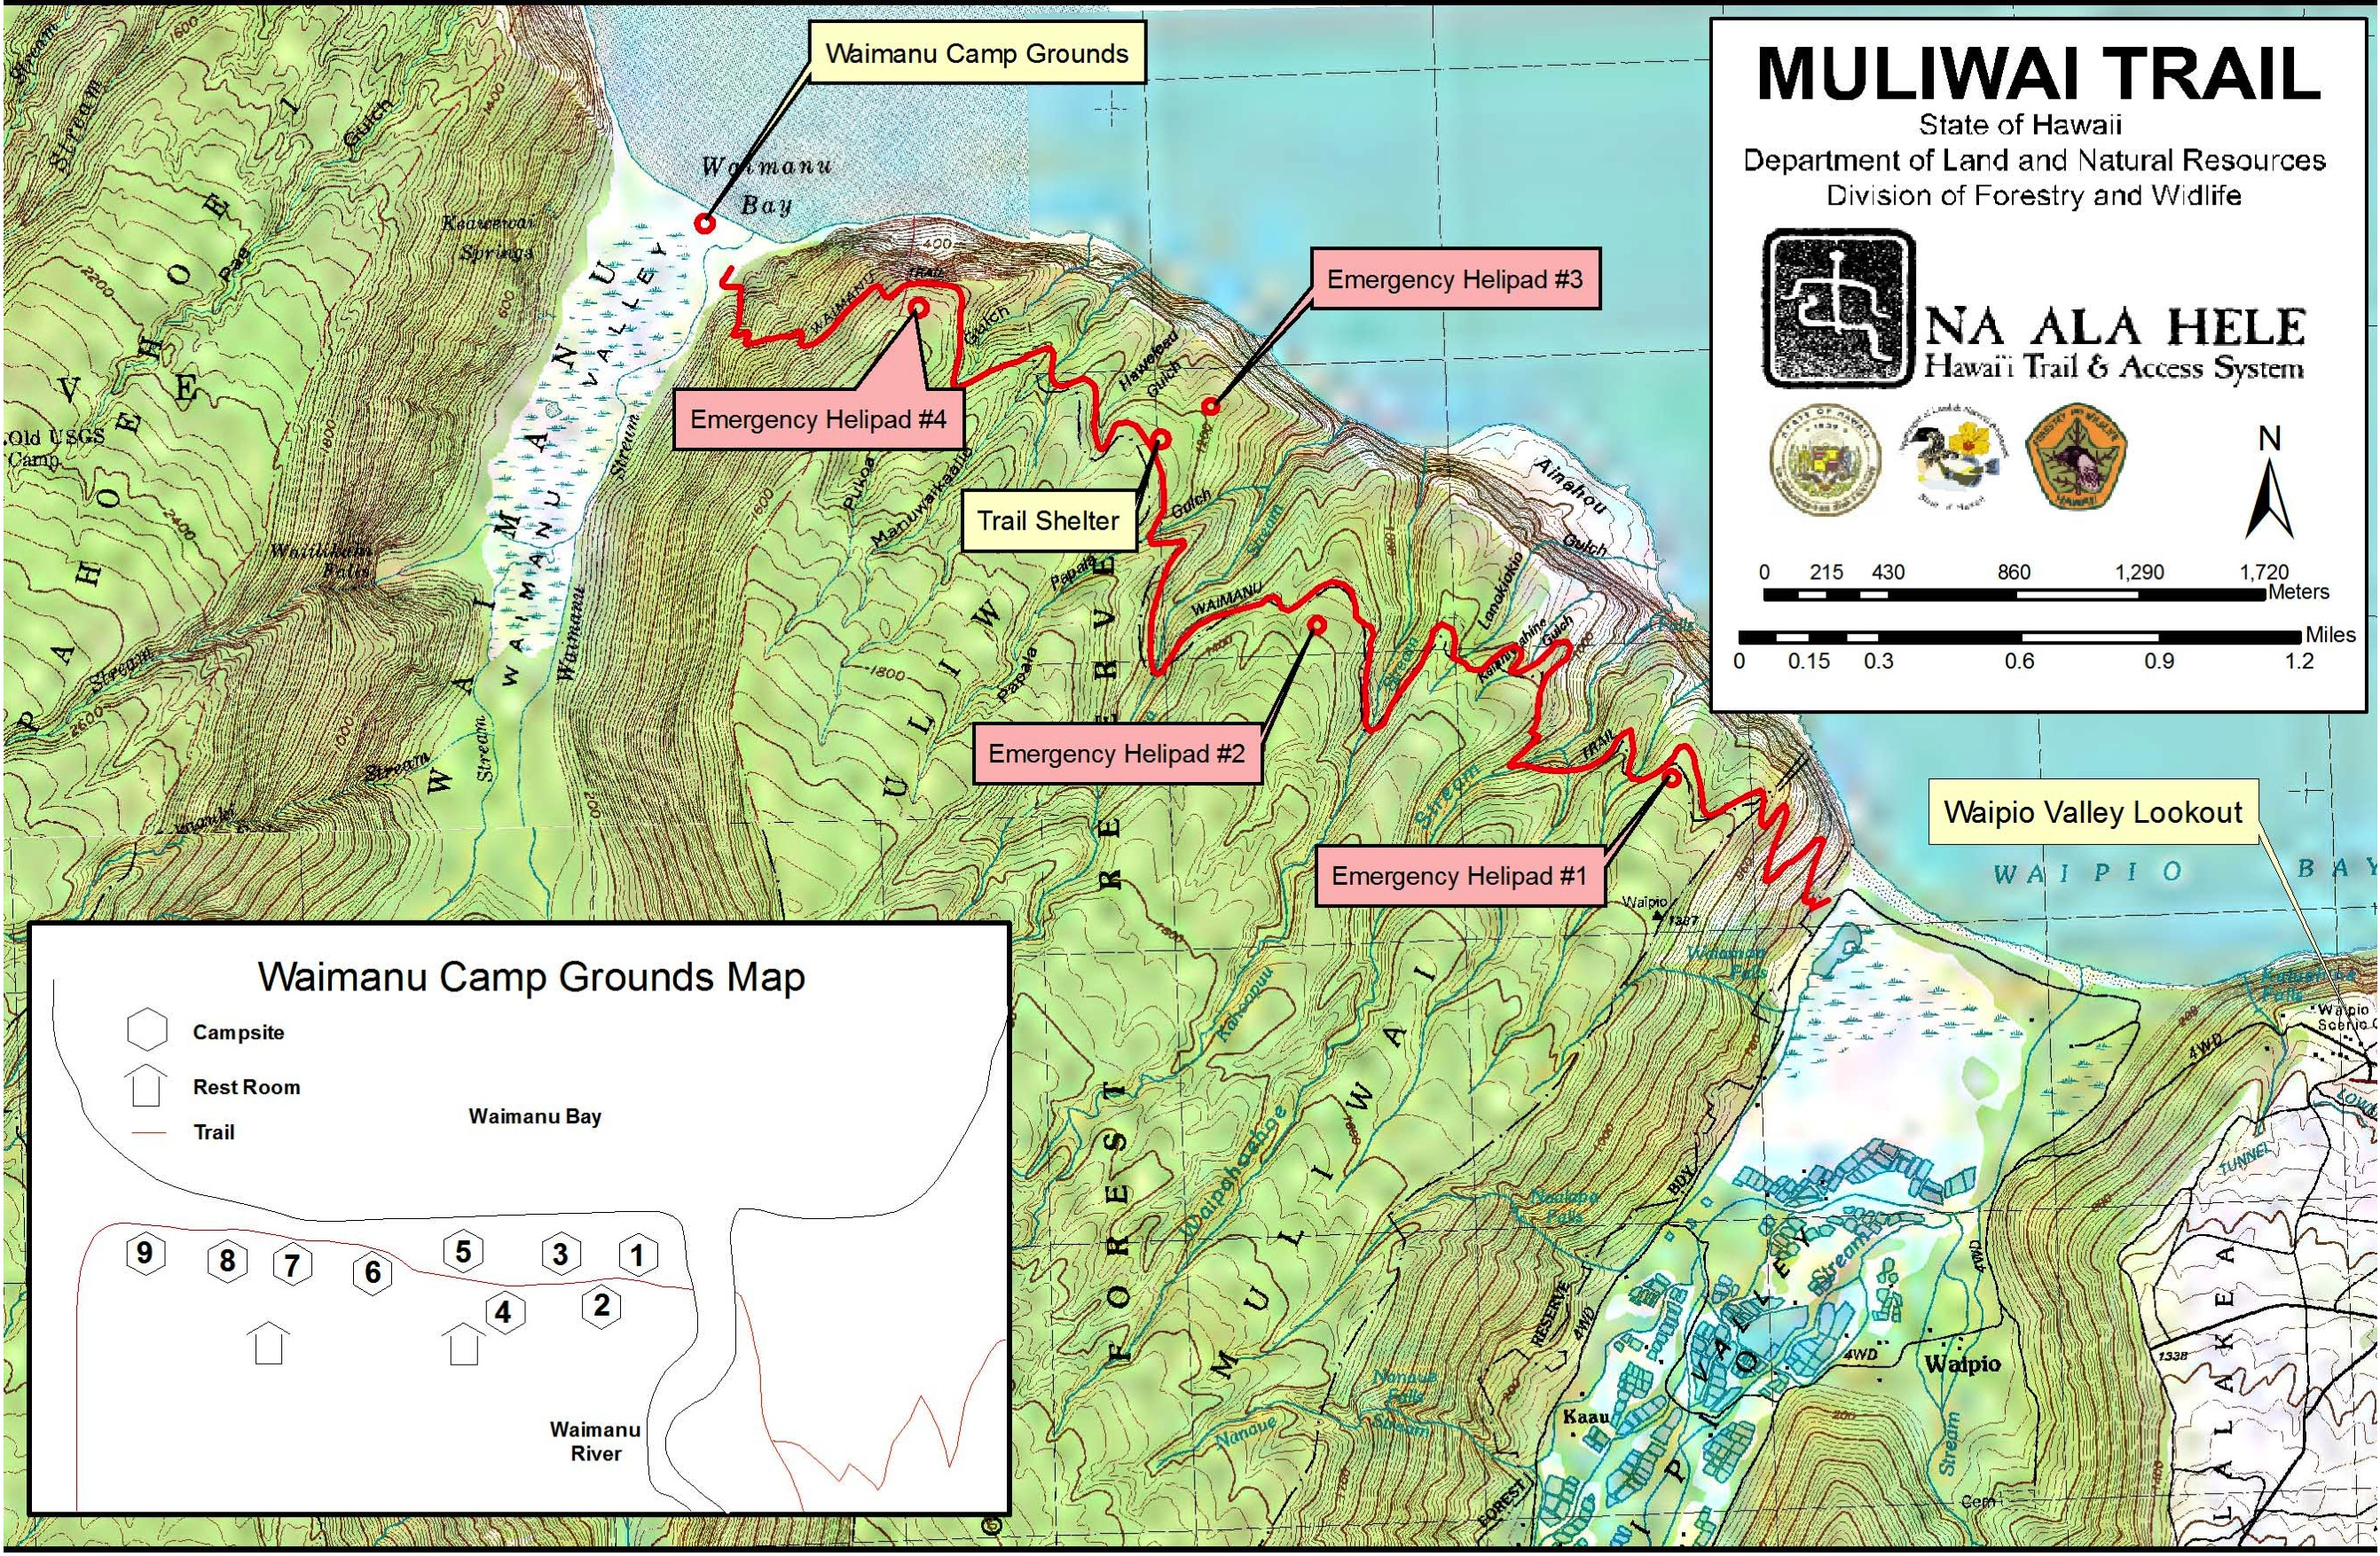
Waipio Muliʻwai

Slide 9
Papakū Makawalu
(Kumulipo – Wā ʻUmikūmākolu)
Papakū Makawalu is the ability of our kupuna Sacred Keepers of knowledge to categorize and organize our natural world and all systems of existence within the universe. Papakū Makawalu is the foundation to understanding, knowing, acknowledging, becoming involved with, but most importantly, becoming the experts of the systems of this natural world.
Papakū Makawalu connotes the dynamic Hawaiian worldview of the physical, intellectual and spiritual foundations from which life cycles emerge. Papakū Makawalu is an abstract from Wā ‘Umikūmākolu (section 13) of the Kumulipo. Wā ‘Umikūmākolu begins with Palikū and Paliha‘a, the male and female ancestors of Haumea. Haumea is the ancestor credited for the pedagogy of categorizing and organizing the natural world. The categorizing and organizing of the natural world was divided into three houses of knowledge and the combination of the three houses of knowledge is Papakū Makawalu.

Slide 10
The three major houses of knowledge are foundations for understanding existence and our place in it:
Papahulilani is the space from above the head to where the stars sit. It is inclusive of the sun, moon, stars, planets, winds, clouds, and the measurement of the vertical and horizontal spaces of the atmosphere. It is also a class of experts who are spiritually, physically, and intellectually attuned to the space above and its relationship to the earth.
Papahulihonua is inclusive of earth and ocean. It is the ongoing study of the natural earth and ocean and its development, transformation and evolution by natural causes. It is also a class of experts who are spiritually, physically, and intellectually attuned to this earth and its relationship to the space above and the life forms on it.
Papahānaumoku moves from the embryonic state of all life forces to death. It is the birthing cycle of all flora and fauna inclusive of man. It is the process of investigating, questioning, analyzing and reflecting upon all things that give birth, regenerate and procreate. It is also a class of experts who are spiritually, physically and intellectually attuned to things born and the habitat that provides their nourishment, shelter, and growth.
Papakū Makawalu is a methodical presentation of a holistic preview of the Hawaiian universe.

Slide 11
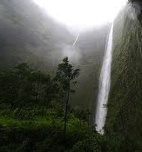
Ahupuaʻa o Napoʻopoʻo

Slide 12
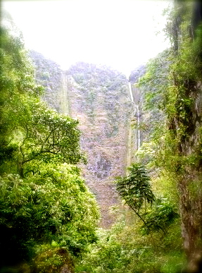
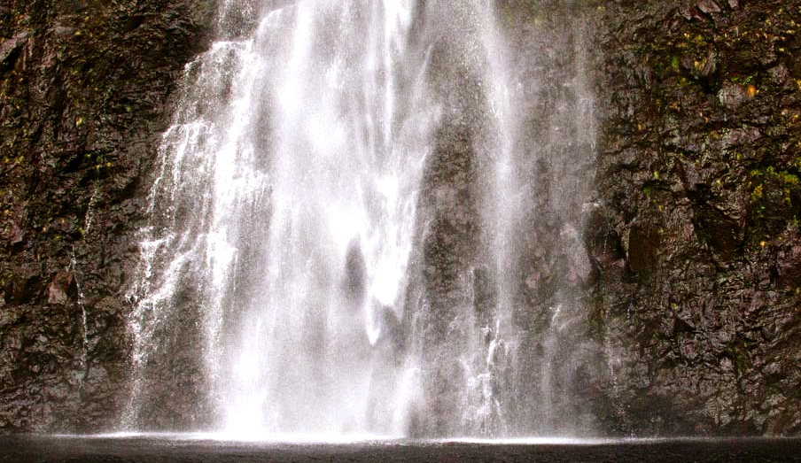
Hiʻilawe
WAIPIO VALLEY: HIʻILAWE FALLS TRAIL
Trailhead: Waipio Valley Overlook at the end of Highway 240 down to the valley floor. Take the road to the left approximately 0.75 mile to the trail. Our company will take you through the Valley, with our sacred relationships that make it possible for you to stay and experience the actual life in one of the world’s truly exotic and breath-taking locations. Enjoy our company and "talk story" about the historical traditional life and culture in one of the most precious Valleys in all Hawaii.
This is the perfect sacred natural Hawaiian experience for a family of four, together connecting to the land as one.
(Hamakua District)
Incredible and extraordinary view of a 1,600 feet waterfall.

Slide 13
Healing Waters of Hawai’i
The shimmering Healing waters of Hawai`i
Brings a gentle touch that once was never known
The surging waters of Hawai`I Wash my sorrows and all, my mind out to sea
Behold my island ever kissed by early evening skies
Embrace the vibrant sunset carried on with the sounds that ever call to you
The tranquil touch of Hawai`I
Brings me the Love I have known so long ago
To this sacred shores of my Hawai`i,
Unlike space, will never wither away, As I know I've found a paradise, heavenly embraced in this Sacred Valley Hear the chatter of a mele “Song” with love in a compassionate melody
Hawai`i, with your sacred shores I've learned of the everlasting truth Hawai`i, with your passion of thy beauty once unknown
Hiʻilawe thy empress of thy cascading Waterfall full of life with a graceful touch by sight
Here my heart that will ever trickle, to be sincere beneath the moon of Mahina. Come to feel the healing waters of Hawai`i. My loving island of Hawai`I. My Great Kingdom of my heart that will always yearn to stay Into your arms of my Hawai`i
I shall ever embrace my love to be with her so ever more. Behold this sacred Valley of mine, ever transforming but always still the same. Once you feel you, I will discover this Sacred Breath of calling unto you.
Hawai`i, sacred Waterfalls I've learned of this everlasting truth with your passion of thy beauty once unknown
Hiʻilawe thy empress of thy cascading Waterfalls full of life with a graceful touch by sight
Hear my heart that will ever trickle o Hiʻilawe, to be sincere beneath the moon of Mahina.
Feel the healing waters of Hawai`i

Slide 14
Kûmaka ka `ikena iâ Hi`ilawe
Ka papa lohi mai a`o Maukele
Pakele mai au i ka nui manu
Hau wala`au nei puni Waipi`o
`A`ole nô wau e loa`a mai
A he uhiwai au no ke kuahiwi
He hiwahiwa au na ka makua
A he lei `â`î na ke kupuna
*(A he milimili ho`i na ka makua)
No Puna ke `ala i hali `ia mai
Noho i ka wailele a`o Hi`ilawe
I ka poli nô au o Ha`i wahine
I ka poli aloha o Ha`inakolo
Ho`okolo `ia aku i ka nui manu
I like ke ka`ina meka uahoa
He hoa `oe no ka lâ le`ale`a
Na ka nui manu iho haunaele
E `ole ko`u nui piha akamai
Hala a`e nâ `ale o ka moana
Hao mai ka moana kau e ka weli
Mea `ole na`e ia no ia ho`okele
Hiʻilawe
All eyes are on Hi`ilawe
In the sparkling lowlands of Maukele
I have not been trapped by the gossip
Chattering everywhere in Waipi`o
I am not caught
For I am the mist of the mountains
I am the darling of the parents
And a lei for the necks of grandparents
*Beloved of my parents
The fragrance is wafted from Puna
And lives at Hi`ilawe waterfall
I was at the bosom of Ha`i, the woman
At the beloved bosom of Ha`inakolo
Annoyed at the many birds
They were indifferent to the distress they caused
You are my companion in the day of joy
The many birds there caused a commotion
It is my great skill
The waves of the ocean overwhelm us
The ocean rages fearfully
But my steering is skillfull

Slide 15
Hiʻilawe
Ho`okele o `uleu pili i ka uapo
Honi malihini au me ku`u aloha
He aloha ia pua ua lei `ia
Ku`u pua miulana poina `ole
Ha`ina `ia mai ana ka puana
Kûmaka ka `ikena iâ Hi`ilawe
*(No Puna ke `ala i hali `ia mai)
Hurry, let us go close to the wharf
I am your new love to be kissed
My flower, my lei, my love for you
Is unforgettable like the muilan flower
Tell the refrain
All eyes are on Hi`ilawe
*The fragrance is wafted from Puna

Slide 16
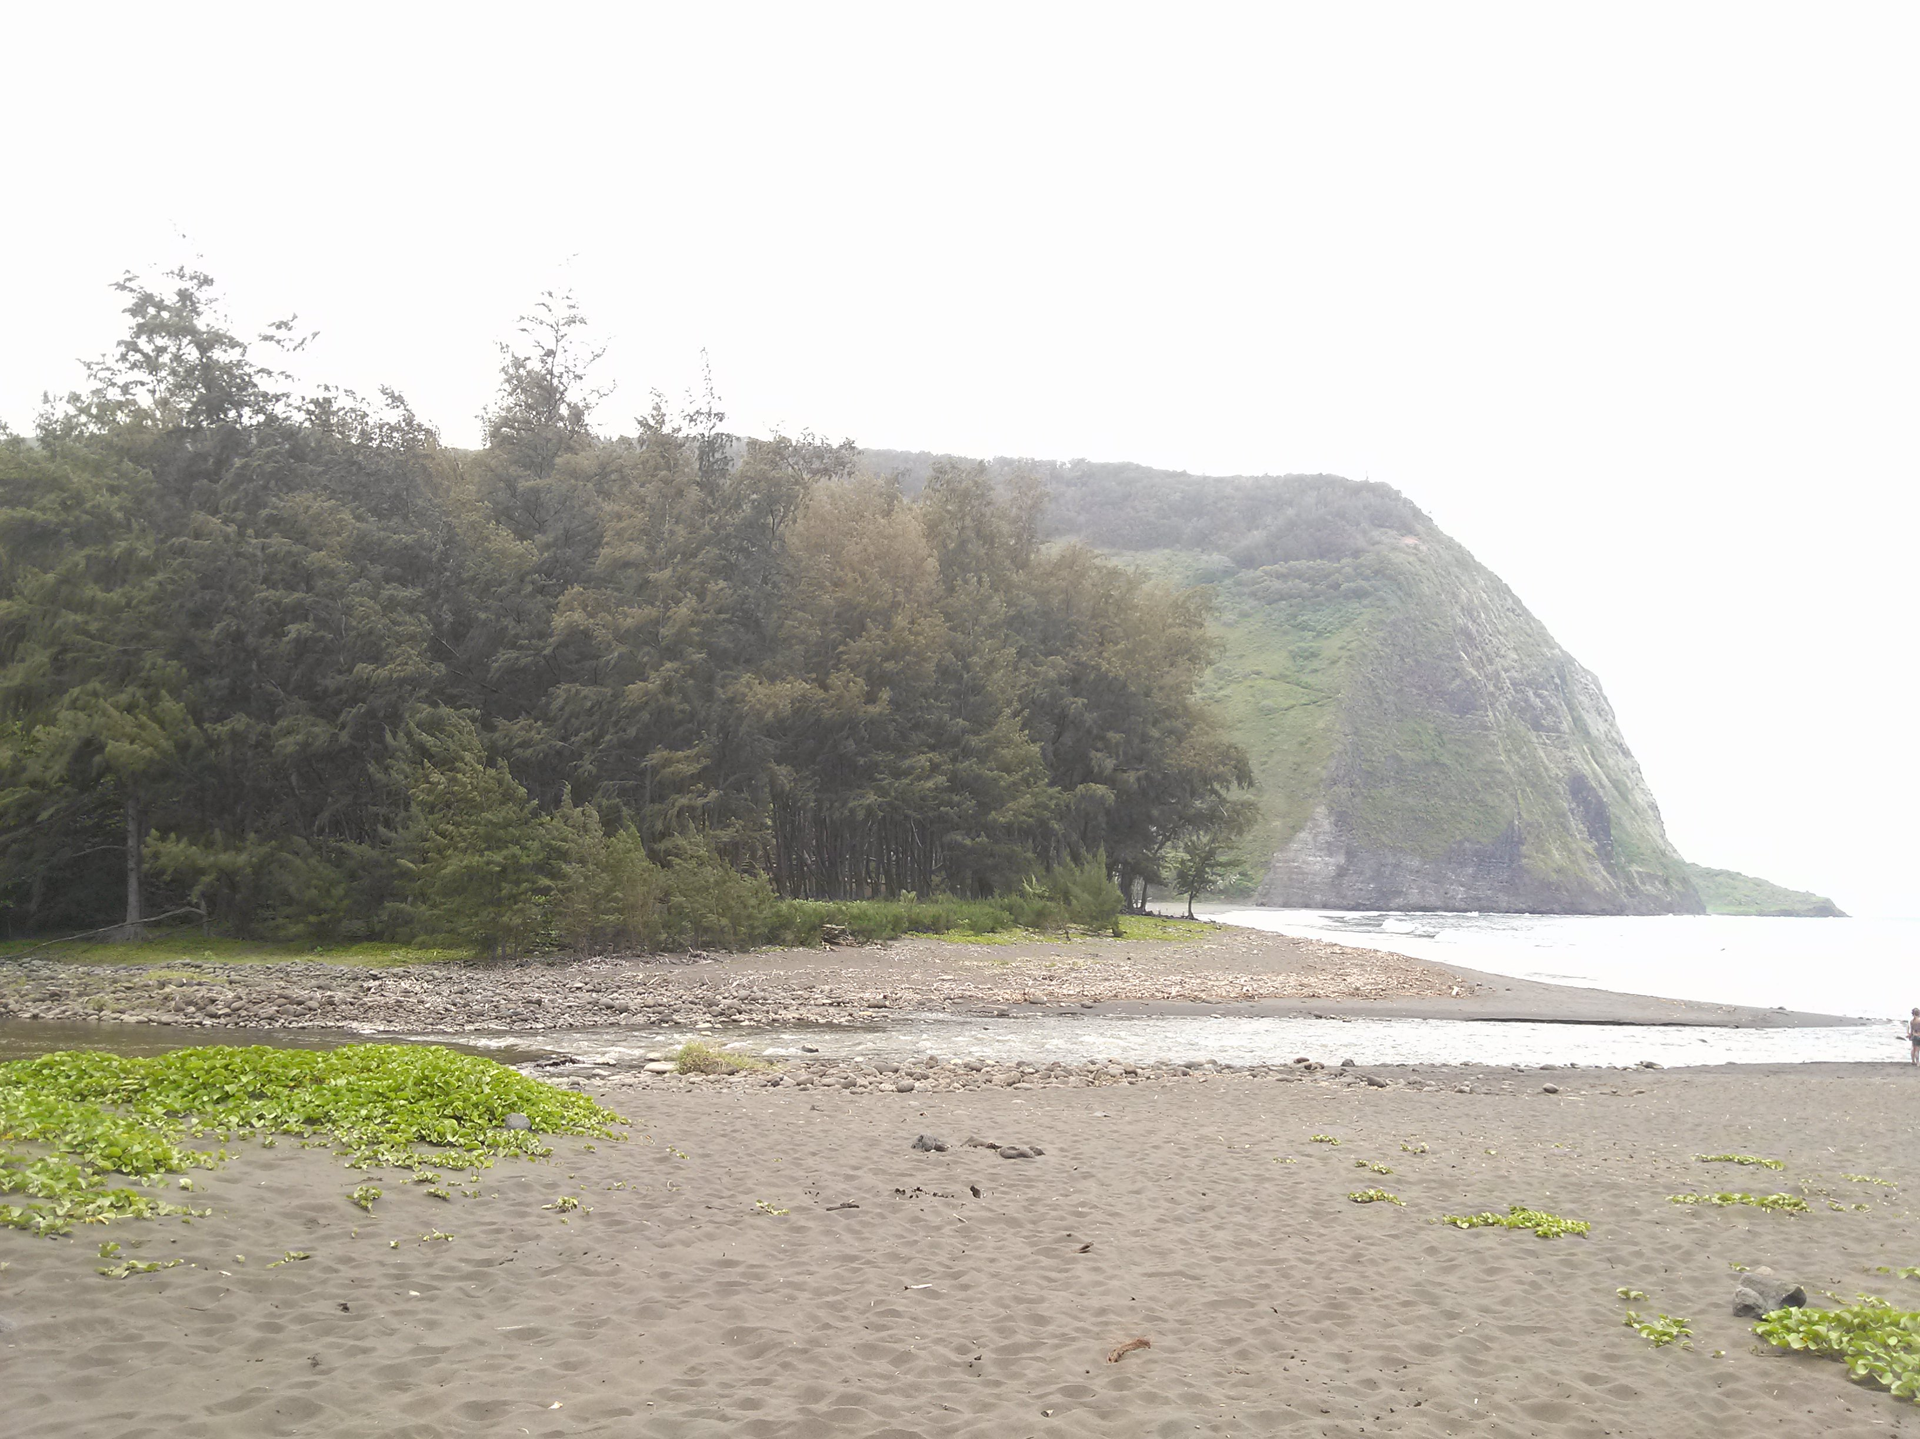
Waipio Muliʻwai

Slide 17
Waipiʻo is a mystical place. Many of the ancient stories of our Hawaiian gods are set in Waipiʻo. It is here that beside the falls of Hiʻilawe, the brothers of Lono found Kaikiani dwelling in a Ullu “breadfruit” grove.
Lono descended on a rainbow and made her his wife only to later eliminate her when he discovered a chief of the earth made love to her. As she died she assured Lono of her innocence and her love for him.
In her honor Lono instituted the Makahiki games - a designated period of time following the harvesting season when wars and battles were ceased, sporting competitions and contests between villages were organized, and festive events were commenced.
Another story set in Waipi`o tells how the people of Waipiʻo came to be safe from the attack of sharks. It is the story of Pauhiʻu Paupoʻo, better known as Nanaue, the shark-man.

Slide 18
Waipi`o Paka`alana
Aia i Waipi`o Pâka`alana e
Paepae kapu `ia o Lïloa e
He aloha ka wahine pi`i i ka pali
Pû`ili ana i ka hua `ûlei
I ka `ai mo`a i ka lau lâ`au
Ho`ola`au mai o Kawelowelo
**Ua pe`e pâ Kaiâulu o Waimea
E ola o Kukeolo`ewa e
There at Waipi`o is Pâka`alana
And the sacred platform of Lïloa
Beloved is the woman who ascended the hill
With armfulls of `ûlei boughs
Her food cooked with the branches of the trees
She for whom Kawelowelo always longed
Hidden from the stinging Kaiâulu of Waimea
And long may Kukeolo`ewa still live
This ancient chant is a mele inoa for Kamehameha Nui. Waipi`o is a valley is the seat of government of Liloa, ancient king of Hawai`i, the father of Umi. Paka`alana was the temple and residence of King Liloa.
Verse 1, paepae was the doorsill of the temple, held in high esteem, for it represented all of the building.
Verse 2, wahine pi`i ka pali is from the legend of Haina-kolo, a Hawaiian chiefess who married her cousin, a king of Kukulu-o-Kahiki, was deserted by him, swam back to Hawai`i with her small child and arrived at Waipi`o in a state of hunger.
Verse 3, She climbed the cliffs and ate of the `ûlei berries without offering the deity of Waipio a sacrifice; a great offense. As punishment she became distraught and wandered away into the wilderness of Waimanu. After a long search her husband found and repented for her. With kind consideration, she regained her understanding and her family was happily re-united.
Verse 4. Kai-a-ulu is a fierce rain squall that arises suddenly in the uplands of Waimea. For protection, one crouches (pe`e) behind grass or hastily builds a shelter. Kukeolo`ewa was an evil demon.

Slide 19
The heiau of Paka‘alana was rededicated in Waipi‘o Valley where Līloa held his court. This heiau existed a century earlier during the time of Kila, son of Mo‘ikeha of Kaua‘i. This heiau was under the care of the kahuna of the Pā‘ao order, who also cared for Līloa’s war god, Kūkā‘ilimoku. New KiʻI images of the house posts was replaced through the protocols of the Sacred Keepers. The heiau was used to offer prayers and thanks during the time of Kū, god of war, and Lonoikamakahiki, god of peace.
The marriage of the Sacred Blood Lines was another way to maintaining peace and consolidating the Mana “power” of Līloa’s high-ranking wife, Pinea, that was of the younger sister of his mother from a line of chiefs on O‘ahu. With her hand they conceived a son by the name of Hākau that became his heir. From another wife, Haua, a Maui chiefess, he had a daughter, Kapukini. Both of these marriages established ties between high-ranking families outside the Kingdom of Hawai ‘I Island.
Līloa’s permanent Royal Court, Kahaunokama‘ahala, is located under the sand dunes along Wailoa stream of Waipi‘o Valley.
At the bottom the cliffs cut off this Sacred Valley of the Kings from outside that results in the Power of the Majestic Beauty of Hawaiʻi.

Slide 20
Pakaʻalana
Another prominent legend is the story of ʻUmi, son of Lïloa. It is said that Lïloa, on a journey to Pauʻ̈uilo, meets a beautiful woman, Akahi. They spend the night together and conceive a child. Lïloa tells Akahi that if she has a son, to name him ʻUmi. Before departing, he leaves behind his malo, a whale tooth necklace and his war club as tokens to the unborn child. Umi is born and when he becomes a young man, Akahi tells him of his true heritage and tells him to go to his father in Waipiʻo Valley. She gives ʻUmi the gifts Lïloa left and instructs him that upon meeting his father, to sit on his father’s lap and tell him who he is. ʻUmi becomes the favored son and Hakau, Lïloa’s other son is enraged with jealousy. Upon Lïloa’s death, Hakau inherits the land, but ʻUmi is placed in charge of the gods and the temples. Hakau poorly treats ʻUmi which drives him to leave Waipiʻo Valley. Hakau extends this mistreatment to the people of Waipiʻo, and ʻUmi, upon hearing this, returns to attack Hakau and kills him. Umi then assumes Hakau’s position as chief.

Slide 21
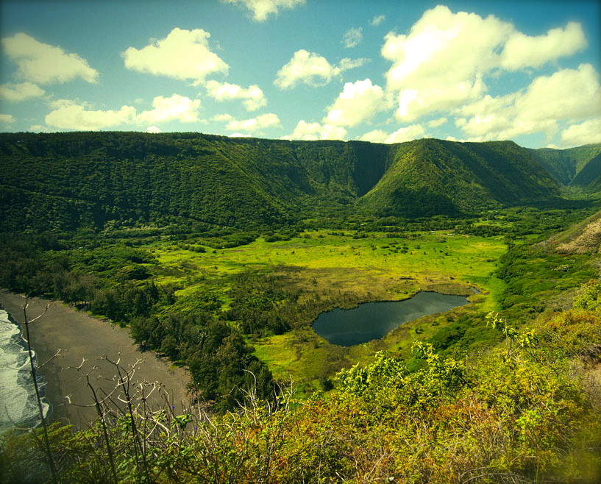
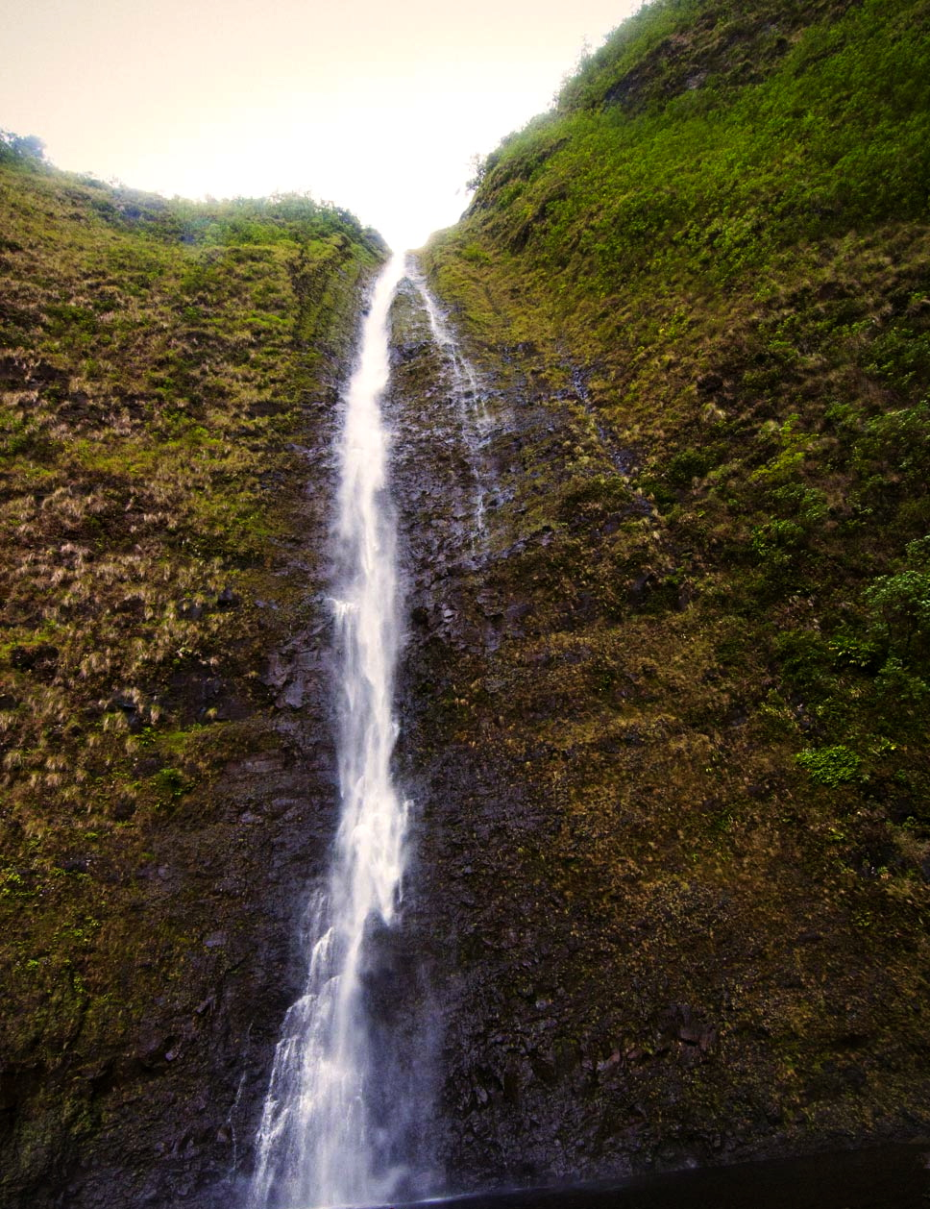
General Information: Camping in Waimanu is allowed in designated campsites only and requires a permit. A Trail Guide is provided from the Malama Waipio Ohana. Mosquito repellant is recommended.
CAUTION: The trail is steep, deeply eroded in places, rocky, muddy and in slippery condition when wet. Only experienced hikers in good physical condition should attempt hiking this trail. The trail is only minimally maintained. Since weather in the area is unpredictable, always carry good rain gear. Perennial and intermittent streams quickly rise to hazardous levels during heavy rains in the area and upper slopes. Never attempt to ford streams at high levels. Shelter and emergency rations are advised. Be alert for centipedes which thrive in the leaf litter and rocks in the campsite area. Their bite is extremely painful.

Slide 22
WAIPIO / WAIMANU VALLEY - MULIWAI TRAIL
(Na Ala Hele Hawaii Trail & Access System)
Difficulty: Challenging and strenuous (recommended for experienced hikers). Highest point: 1320 feet, lowest sea level.
Trail Distance: 18 miles roundtrip / 12 hours.
Trailhead: Take Highway 240 to the Waipio Lookout (eastern end of valley). A steep jeep road extends from the lookout down into the valley. Upon reaching the valley floor, take the road to the right, then follow the beach to Wailoa Stream. The narrow, steep and rough road ends at the stream. Cross the stream and follow the Ala nui trail on the sand mounds to the west side of Waipio Valley and the beginning of the Muliwai trail.
Route: The Muliwai Trail zig-zags up the western wall of Waipio Valley, climbing approximately 1,200 feet to the highland between Waipio and Waimanu Valleys. It leads across the highland area to Waimanu Valley, crossing twelve gulches 400 to 500 feet in depth, then descends 1,200 feet into Waimanu Valley.
(Hamakua District)
The Muliwai Trail is an old Hawaiian trail used for access between the Waipio and Waimanu valleys on the Hamakua Coast. These beautiful valleys are rich in cultural history having supported large populations of Hawaiians in the past. Vegetation along the trail consist of native forest interspersed with exotics.

Slide 23
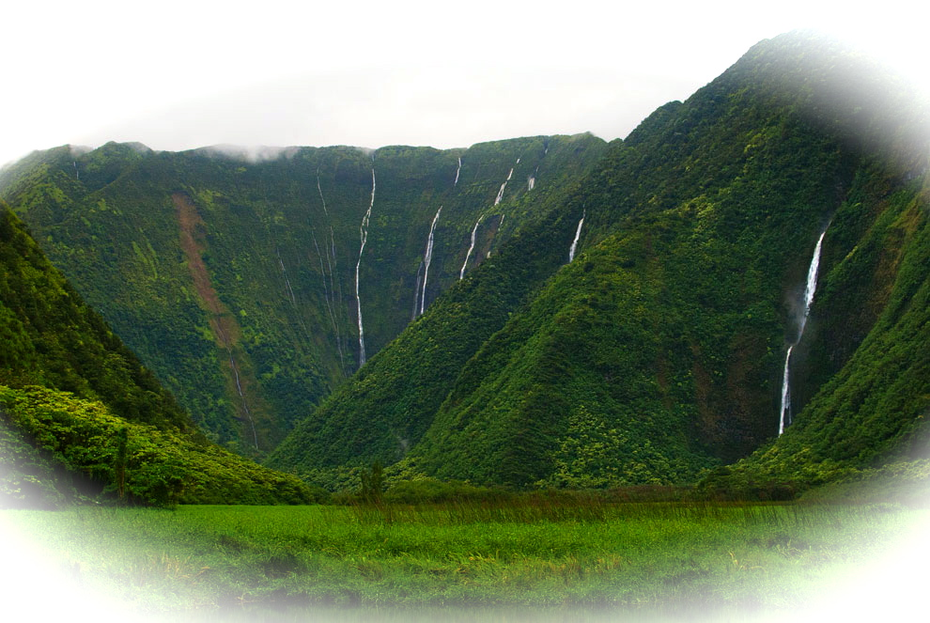
Waimanu Valley
Kamehameha the Great in Waipio Valley
It was at Waipio in 1780 that Kamehameha the First received his war god Kukailimoku who proclaimed him the future ruler of the islands.
It was off the coast of Waimanu, that Kamehameha engaged Kahekili, the Lord of the leeward islands, and his half-brother, Kaeokulani of Kaua'i, in the first naval battle in Hawaiian history - Kepuwahaulaula, known as the Battle of the Red-Mouthed Guns.
Kamehameha thus began his conquest of the islands.

Slide 24
Sites of Waipio

Slide 25
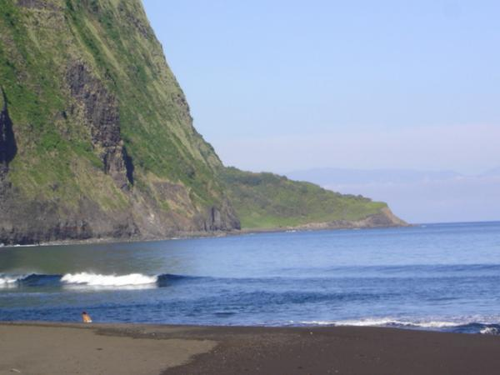
Waipio Valley
“The Valley of the Kings”

Slide 26
Waipio Gift Shop

Slide 27
Camping on the Big Island
If you are on Hawaii for your much-deserved holiday, camping is probably not the first thing that comes to mind when you think about how you will be spending your nights. Sure, you will not be as comfortable in your tent as you will be in that cozy vacation rental you just booked for your family, but camping can add an element of adventure - or romance!- to your vacation, and give you memories to treasure for the years to come!
Permits and Campsites | 7 Handy Camping Tips | Campsite pictures
Are you curious where you will pitch your tent? Have a look at our gallery of campsites on the Big Island!
camping can add an element of adventure - or romance!- to your vacation, and give you a memory to treasure for the years to come!
Just think about dozing off with the sound of the braking waves on the background, while you watch the stars overhead. Or what about spending the night with your family and/or friends over freshly grilled fish from the BBQ? And did you know you can also camp on top of the worlds most active volcano? Just be sure to pack some warm clothes because nights will get chilly at 4000 ft elevation.

Slide 28
Did you know you can also camp on top of the worlds most active volcano?
All in all, camping on the Moku o Hawaii “Big Island” is a sensual unique and exciting experience! It doesn't offer the comfort that you can find in a real bed, but if you are an outdoorsy type, you will find many rewards. There are many campgrounds to choose from in an array of different climates, and spending at least part of your vacation under the star-gazing sky of Hawaii!
Do you need a camping permit for...
..Hawaii County Parks? YES!
Permits are required for all 10 county parks that allow camping. You can book a campsite online via the official Big Island Camp Reservation System. Permits can be purchased up to a year in advance, see the camp reservation website for prices and other details.
The following Hawaii County Parks allow camping. Please note that the facilities vary for each campsite, and that some sites have no potable water.

Slide 29
Just think about watching the stars overhead, then falling into a mystical sleep with the sounds of the trickling river flow through the muliwai embracing the braking waves as your background lullaby. Or what about spending the night at Kona Lani Farm Private Resort setting with your family and/or friends over freshly grilled fish from the BBQ or feasting on a Hawaiian Luaʻa with Kalua puaʻa? And did you know you can also camp on top of the worlds most active volcano?
All in all, camping on the Moku o Hawaii “Big Island” is a unique and exciting experience! It doesn't offer the comfort that you can find in a real bed like at Kona Lani Farm, but if you are an outdoorsy type, you will find many rewards. There are many campgrounds to choose from in an array of different climates, and spending at least part of your vacation under the star-gazing sky of Hawaii!

Slide 30
Aloha and Mahalo Nui!
Kahea Design LLC

