Slide 1
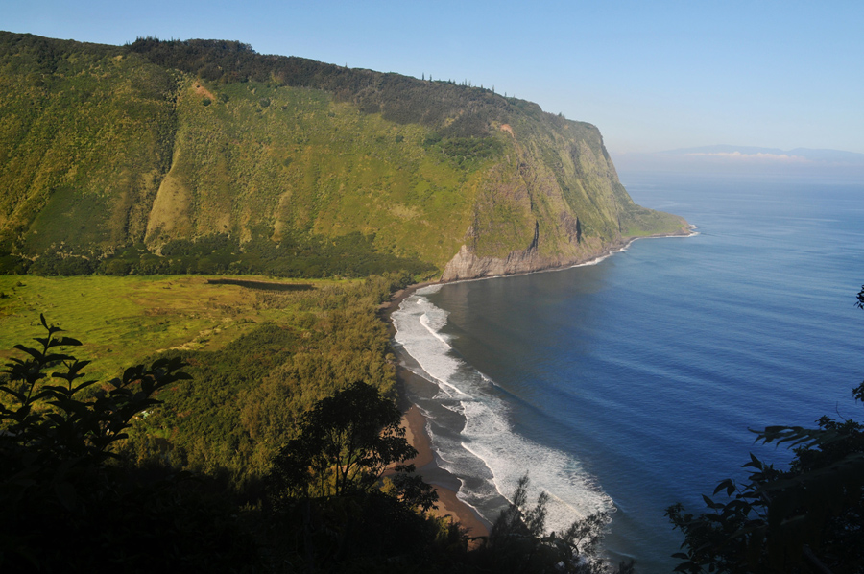
Waipio Valley
“The Valley of the Kings”

Slide 2
Kosei Travel USA
2013 Valley of the Kings
Kahea Design LLC
73-1749 Hao Street, kailua Kona Hawaii, 96740
Melvin G. Mason Jr (808) 987-3192 kaneuhanenui@gmail.com
Susanna Nordlund (808) 430-6657 nordlund.susanna@gmail.com
www.kaheadesign.com
Kahea Design LLC
All Rights Reserved
© 2012-2013

Slide 3
Vision Statement
Advocate bringing forth the Hawaiian Education of the Traditions and Culture through Ancient Kupuna Knowledge and Wisdom!
Mission Statement
To support Waipio Valley by providing access to learning in an educational environment in the openness of nature, with a Cultural exploratory sense and outreach educational program organizationally housed in Ka Ha O Na Kupuna School of Ancient Hawaiian Knowledge and Wisdom of Hawaiian Wayfinding, Arts, Traditions and Culture. This is the Hawaiian spiritual actions and the preservation with perpetuation of Hawaiian language at Waipio Valley Education Center.

Slide 4
Cultural Values
Our Hawaiian cultural values stresses the importance of our natural elements. This is a way of Life in an environment that possesses the mana, a spiritual power that can be associated with mythological beings of understanding. Hawaiians’ relationship with the natural elements demonstrates how physical and spiritual our connections impact the sense of community that embraces the success and survival of Life. The Wai “Water” has always been and continues to be an important resource in our well-being. Our Hawaiian values are readily found in our oli “chants”, mele “music and stories.
Our oral traditions seek to illustrate our relationship between the Heavens and our Aina “Land”. It is a true form from a perspective that the traditional water allocation kuleana “responsibility” and ways of Life that we understood in Sacredness. Ahupuaʻa Kuleana understanding of our Ancestral past have served as a guideline for our Ancestral Future of Waipiʻo Valley today.

Slide 5
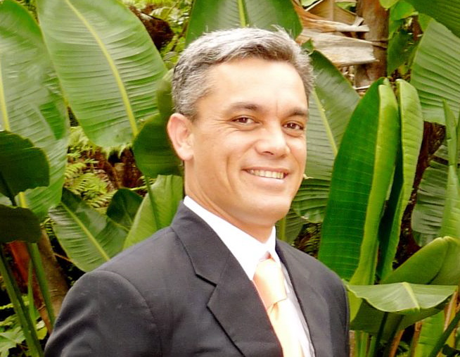
Coordinator - Melvin G. Mason Jr.
Phone: (808) 987-3192 Email: kaneuhanenui@gmail.com

Slide 6
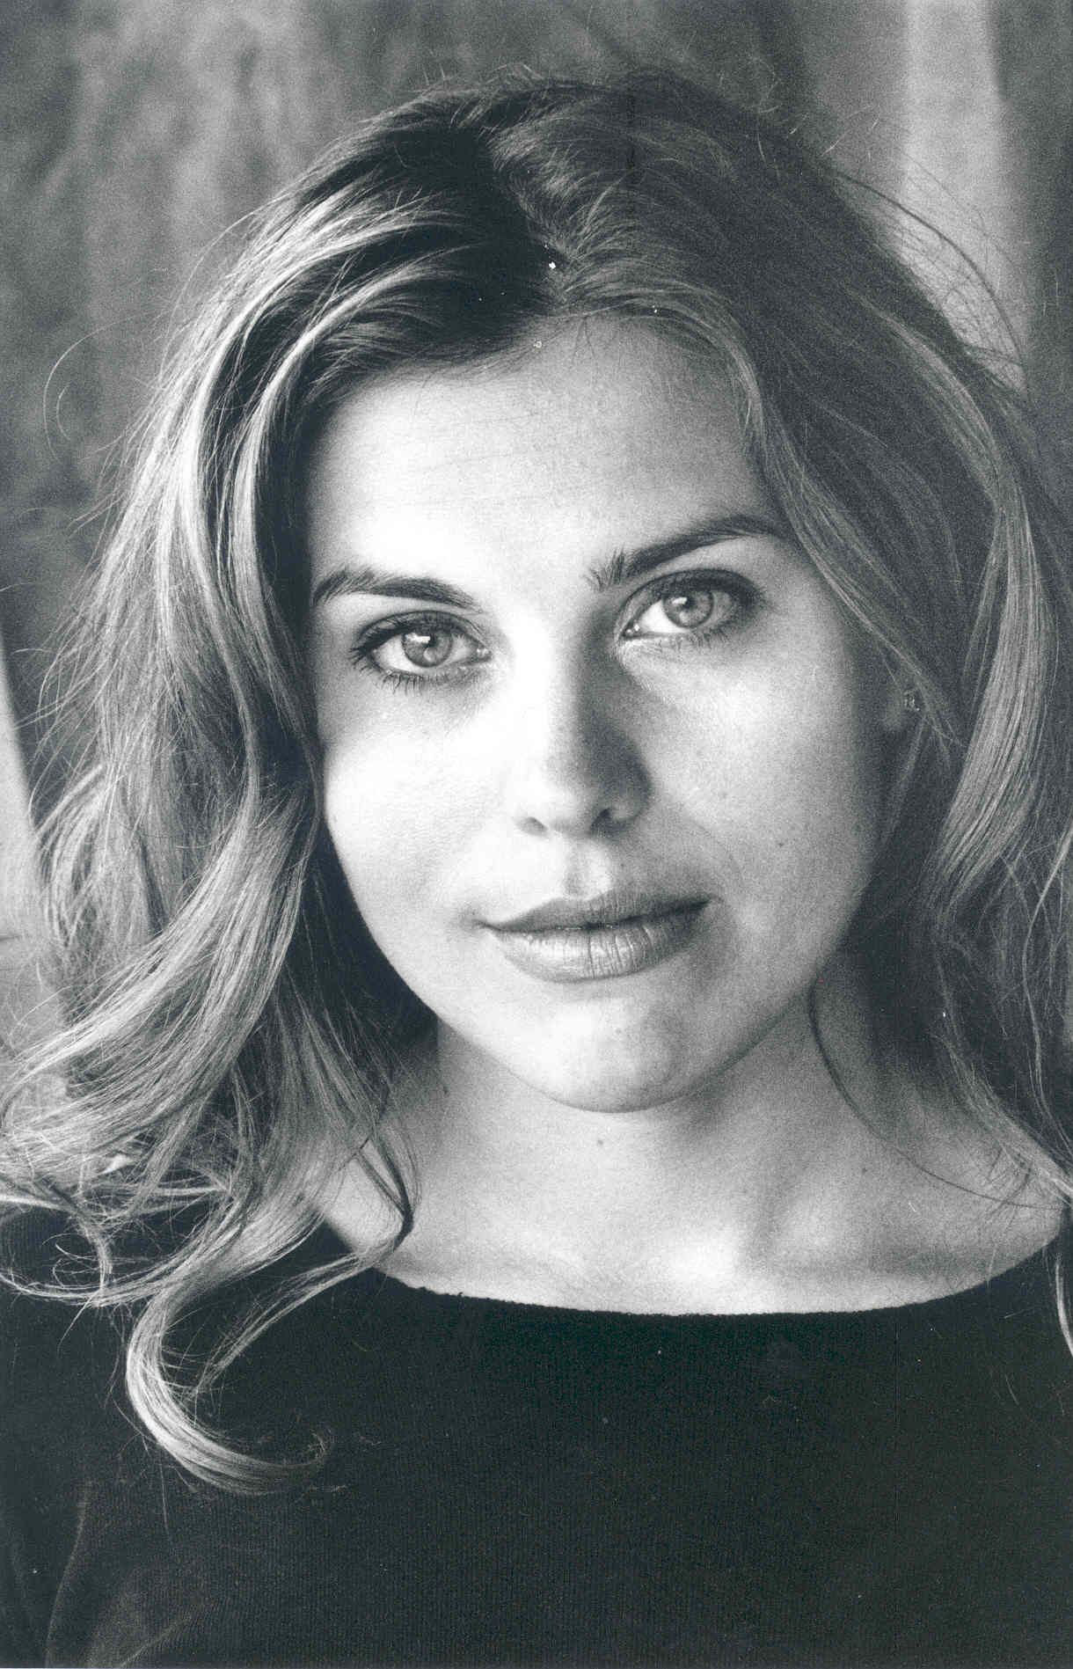
Coordinator - Susanna Nordlund
Phone (808) 430 - 6657 Email: nordlund.susanna@gmail.com

Slide 7
Waipi`o Pâka`alana
Aia i Waipi`o Pâka`alana e
Paepae kapu `ia o Lïloa e
He aloha ka wahine pi`i i ka pali
Pû`ili ana i ka hua `ûlei
I ka `ai mo`a i ka lau lâ`au
Ho`ola`au mai o Kawelowelo
**Ua pe`e pâ Kaiâulu o Waimea
E ola o Kukeolo`ewa e
There at Waipi`o is Pâka`alana
And the sacred platform of Lïloa
Beloved is the woman who ascended the hill
With armfulls of `ûlei boughs
Her food cooked with the branches of the trees
She for whom Kawelowelo always longed
Hidden from the stinging Kaiâulu of Waimea
And long may Kukeolo`ewa still live
This ancient chant is a mele inoa for Kamehameha Nui. Waipi`o is a valley is the seat of government of Liloa, ancient king of Hawai`i, the father of Umi. Paka`alana was the temple and residence of King Liloa.
Verse 1, paepae was the doorsill of the temple, held in high esteem, for it represented all of the building.
Verse 2, wahine pi`i ka pali is from the legend of Haina-kolo, a Hawaiian chiefess who married her cousin, a king of Kukulu-o-Kahiki, was deserted by him, swam back to Hawai`i with her small child and arrived at Waipi`o in a state of hunger.
Verse 3, She climbed the cliffs and ate of the `ûlei berries without offering the deity of Waipio a sacrifice; a great offense. As punishment she became distraught and wandered away into the wilderness of Waimanu. After a long search her husband found and repented for her. With kind consideration, she regained her understanding and her family was happily re-united.
Verse 4. Kai-a-ulu is a fierce rain squall that arises suddenly in the uplands of Waimea. For protection, one crouches (pe`e) behind grass or hastily builds a shelter. Kukeolo`ewa was an evil demon.

Slide 8
A Unique Royal Hawaiian Experience
Our Valley Tours provide guests with an authentic Royal Hawaiian cultural experience in a pristine and tranquil setting with insightful tour guides.
In addition to our specialty tours with individual discernment, our retreat incorporates a healthy whole Hawaiian lifestyle of the Valleys Royal Family, which includes Hawaiiʻs most Sacred Puʻuhonua “Refuge” where the King Kamehameha of Hawaii have been Raised under the Protection of the Prophecy.
Guests will receive this Great Sacred Spiritual Lifestyle and understanding that has been kept in a protection within the Ancestral Descendants of the Kings and Queens Comfort!

Slide 9
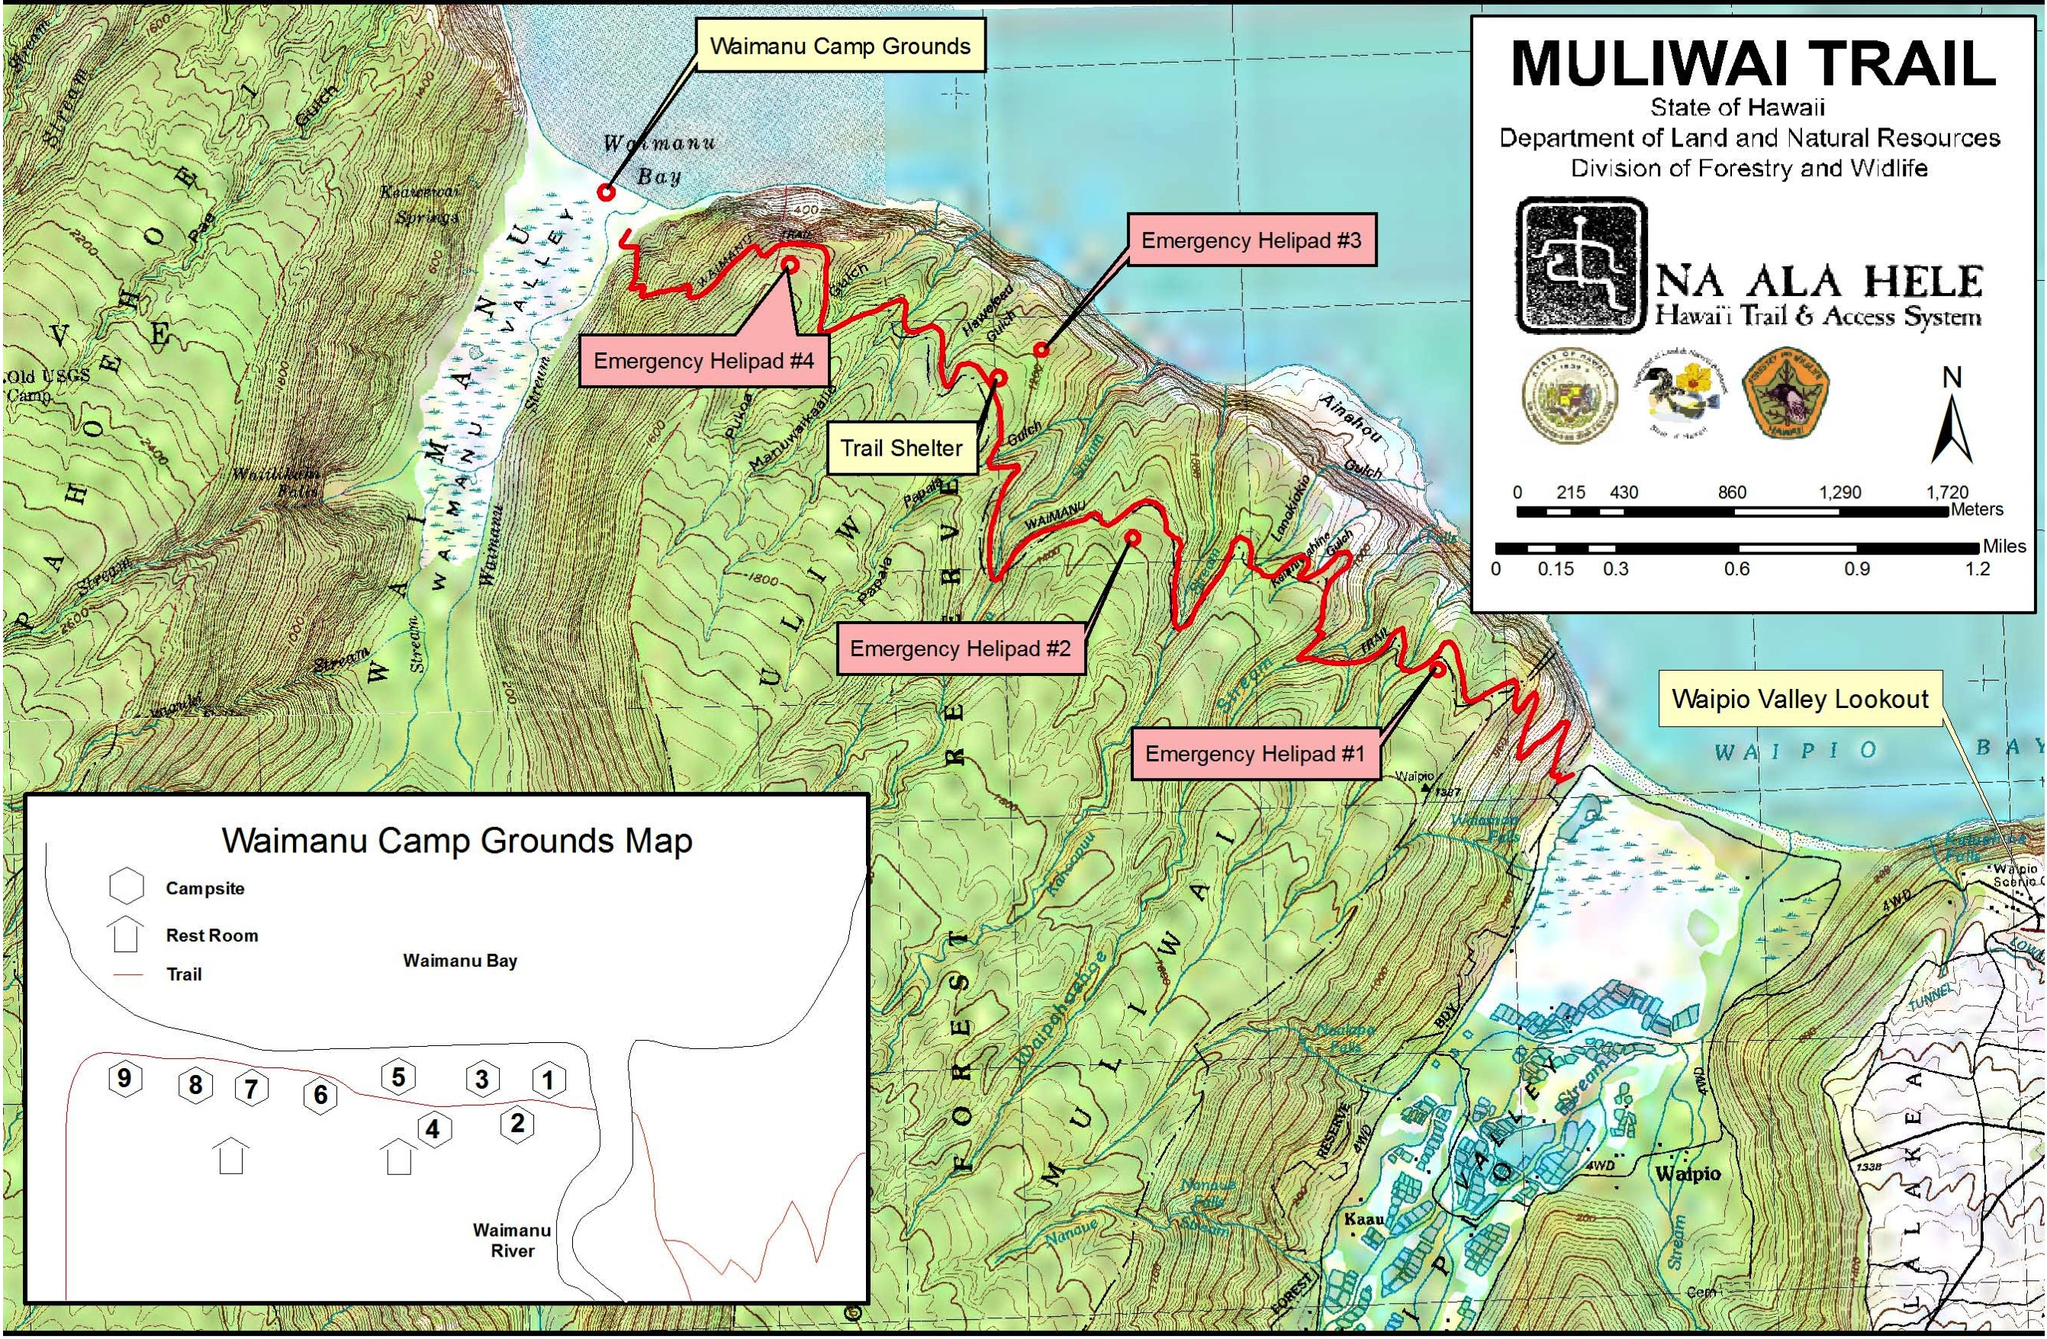
Waipio Muliʻwai

Slide 10
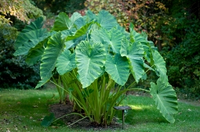
The Story of Haloa:
A Hawaiian Creation Story
Whether whispered or shouted, the name Haloa tells a story of connection between all Hawaiians and there voyage throughout there Journey of the Heavens, a story of connection between People, Nature and the Elements.
As Hawaiians we are one with Haloa, we are one with kalo (taro). May this Elemental Wisdom ever be so.
Wakea - Father Sky and Papa - Mother Earth, creators of our beloved island chain home, conceived a beautiful daughter named Ho’ohokulani, whose name means ‘the making of stars in the heavens’. Wakea and Ho’ohokulani together conceived a child, and the family waited patiently for this birth.

Slide 11
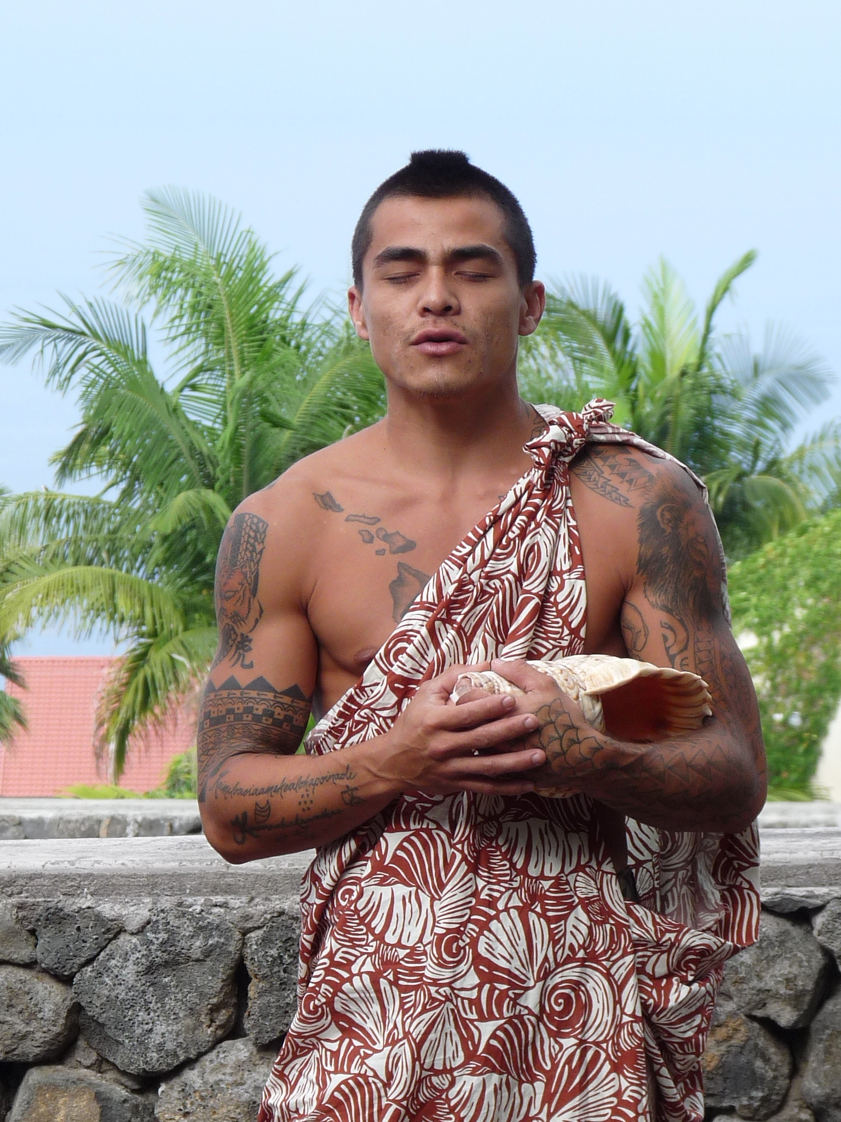
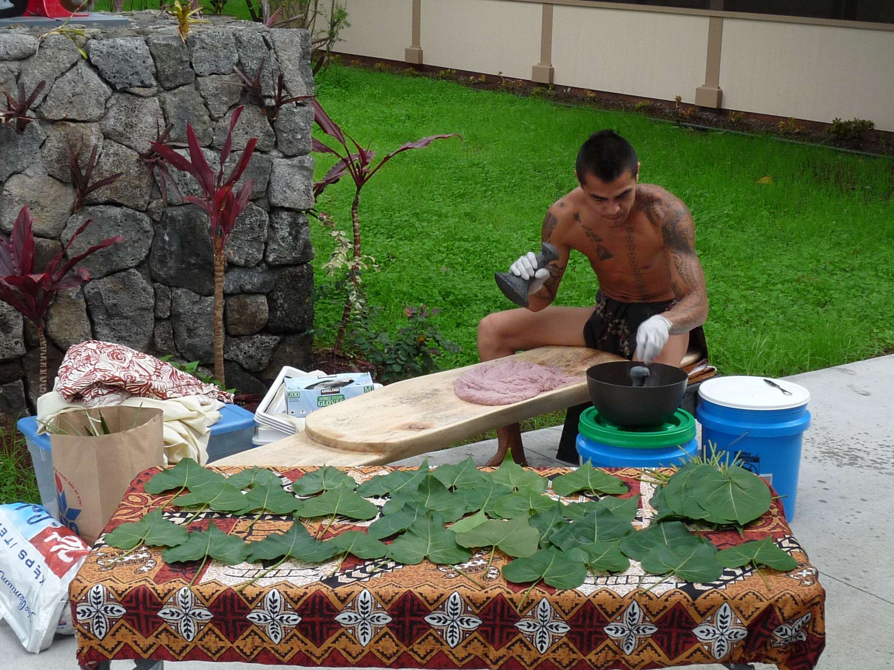
The Breath of Haloa within the Sacred Valley of the Kings "Ahupua'a o Waipio”, guests have a sense of place of this Sacred Ahupua’a.
Kaimi Ma demonstrates the
Ku’i’ai method of processing
Kalo into pa‘i‘ai then into Poi.
Papa ku‘i ‘ai
Pohaku ku‘i ‘ai
Umeke (bowls for water)

Slide 12
Papakū Makawalu
(Kumulipo – Wā ʻUmikūmākolu)
Papakū Makawalu is known to be the foundation for one to stand upon with having the ability of our Kupuna “Sacred Keepers of Knowledge” to categorize and organize our natural world and all systems of existence within the universe. Papakū Makawalu is the foundation to understanding, knowing, acknowledging, becoming involved with, but most importantly, becoming the experts of the systems of our natural well-being and knowing our world.
Papakū Makawalu connotes the dynamic Hawaiian worldview of the physical, intellectual and spiritual intelligence of a foundation from which life cycles emerge. Papakū Makawalu is an abstract from Wā ‘Umikūmākolu (section 13) of the Kumulipo. Wā ‘Umikūmākolu begins with Palikū and Paliha‘a, the male and female ancestors of Haumea. Haumea is the ancestor credited for the pedigree of categorizing and organizing our natural world. The categorizing and organizing of this natural world was divided into three houses of knowledge and the combination of the three houses of knowledge is Papakū Makawalu.

Slide 13
The three major houses of knowledge are foundations for understanding existence and our place in it:
Papahulilani is the space from above the head to where the stars sit. It is inclusive of the sun, moon, stars, planets, winds, clouds, and the measurement of the vertical and horizontal spaces of the atmosphere. It is also a class of experts who are spiritually, physically, and intellectually attuned to the space above and its relationship to the earth.
Papahulihonua is inclusive of Papaʻhonua “mother earth” and Moana Pākīpika “Pacific ocean”. It is the ongoing study of the natural earth and ocean and its development, transformation and evolution by natural causes. It is also a combination class of experts who are spiritually, physically, and intellectually attuned to this earth and its relationship to the space above and the life forms on it.
Papahānaumoku moves from the embryonic state of all life forces to death. It is the birthing cycle of all flora and fauna inclusive of every Kane, Wahine, Keiki and Kupuna. It is the process of investigating, questioning, analyzing and reflecting upon all things that give birth, regenerate and procreate. It is also a class of knowledgeable experts who are spiritually, physically, emotionally and intellectually attuned to things born and the habitat that provides their nourishment, shelter, and growth.
Papakū Makawalu is a methodical presentation of a holistic preview of thee Hawaiian Universe.

Slide 14
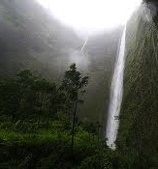
Ahuʻili O Napoʻopoʻo

Slide 15
Healing Waters of Hawai’i
The shimmering Healing waters of Hawai`i
Brings a gentle touch that once was never known
The surging waters of Hawai`I Wash my sorrows and all, my mind out to sea
Behold my island ever kissed by early evening skies
Embrace the vibrant sunset carried on with the sounds that ever call to you
The tranquil touch of Hawai`I
Brings me the Love I have known so long ago
To this sacred shores of my Hawai`i,
Unlike space, will never wither away, As I know I've found a paradise, heavenly embraced in this Sacred Valley Hear the chatter of a mele “Song” with love in a compassionate melody
Hawai`i, with your sacred shores I've learned of the everlasting truth Hawai`i, with your passion of thy beauty once unknown
Hiʻilawe thy empress of thy cascading Waterfall full of life with a graceful touch by sight
Here my heart that will ever trickle, to be sincere beneath the moon of Mahina. Come to feel the healing waters of Hawai`i. My loving island of Hawai`I. My Great Kingdom of my heart that will always yearn to stay Into your arms of my Hawai`i
I shall ever embrace my love to be with her so ever more. Behold this sacred Valley of mine, ever transforming but always still the same. Once you feel you, I will discover this Sacred Breath of calling unto you.
Hawai`i, sacred Waterfalls I've learned of this everlasting truth with your passion of thy beauty once unknown
Hiʻilawe thy empress of thy cascading Waterfalls full of life with a graceful touch by sight
Hear my heart that will ever trickle o Hiʻilawe, to be sincere beneath the moon of Mahina.
Feel the healing waters of Hawai`i

Slide 16
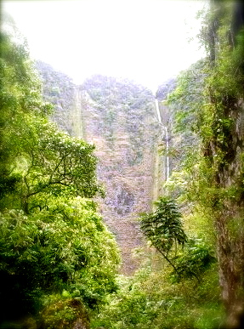
Hiʻilawe

Slide 17
Kûmaka ka `ikena iâ Hi`ilawe
Ka papa lohi mai a`o Maukele
Pakele mai au i ka nui manu
Hau wala`au nei puni Waipi`o
`A`ole nô wau e loa`a mai
A he uhiwai au no ke kuahiwi
He hiwahiwa au na ka makua
A he lei `â`î na ke kupuna
*(A he milimili ho`i na ka makua)
No Puna ke `ala i hali `ia mai
Noho i ka wailele a`o Hi`ilawe
I ka poli nô au o Ha`i wahine
I ka poli aloha o Ha`inakolo
Ho`okolo `ia aku i ka nui manu
I like ke ka`ina meka uahoa
He hoa `oe no ka lâ le`ale`a
Na ka nui manu iho haunaele
E `ole ko`u nui piha akamai
Hala a`e nâ `ale o ka moana
Hao mai ka moana kau e ka weli
Mea `ole na`e ia no ia ho`okele
Hiʻilawe
All eyes are on Hi`ilawe
In the sparkling lowlands of Maukele
I have not been trapped by the gossip
Chattering everywhere in Waipi`o
I am not caught
For I am the mist of the mountains
I am the darling of the parents
And a lei for the necks of grandparents
*Beloved of my parents
The fragrance is wafted from Puna
And lives at Hi`ilawe waterfall
I was at the bosom of Ha`i, the woman
At the beloved bosom of Ha`inakolo
Annoyed at the many birds
They were indifferent to the distress they caused
You are my companion in the day of joy
The many birds there caused a commotion
It is my great skill
The waves of the ocean overwhelm us
The ocean rages fearfully
But my steering is skillfull

Slide 18
Hiʻilawe
Ho`okele o `uleu pili i ka uapo
Honi malihini au me ku`u aloha
He aloha ia pua ua lei `ia
Ku`u pua miulana poina `ole
Ha`ina `ia mai ana ka puana
Kûmaka ka `ikena iâ Hi`ilawe
*(No Puna ke `ala i hali `ia mai)
Hurry, let us go close to the wharf
I am your new love to be kissed
My flower, my lei, my love for you
Is unforgettable like the muilan flower
Tell the refrain
All eyes are on Hi`ilawe
*The fragrance is wafted from Puna

Slide 19
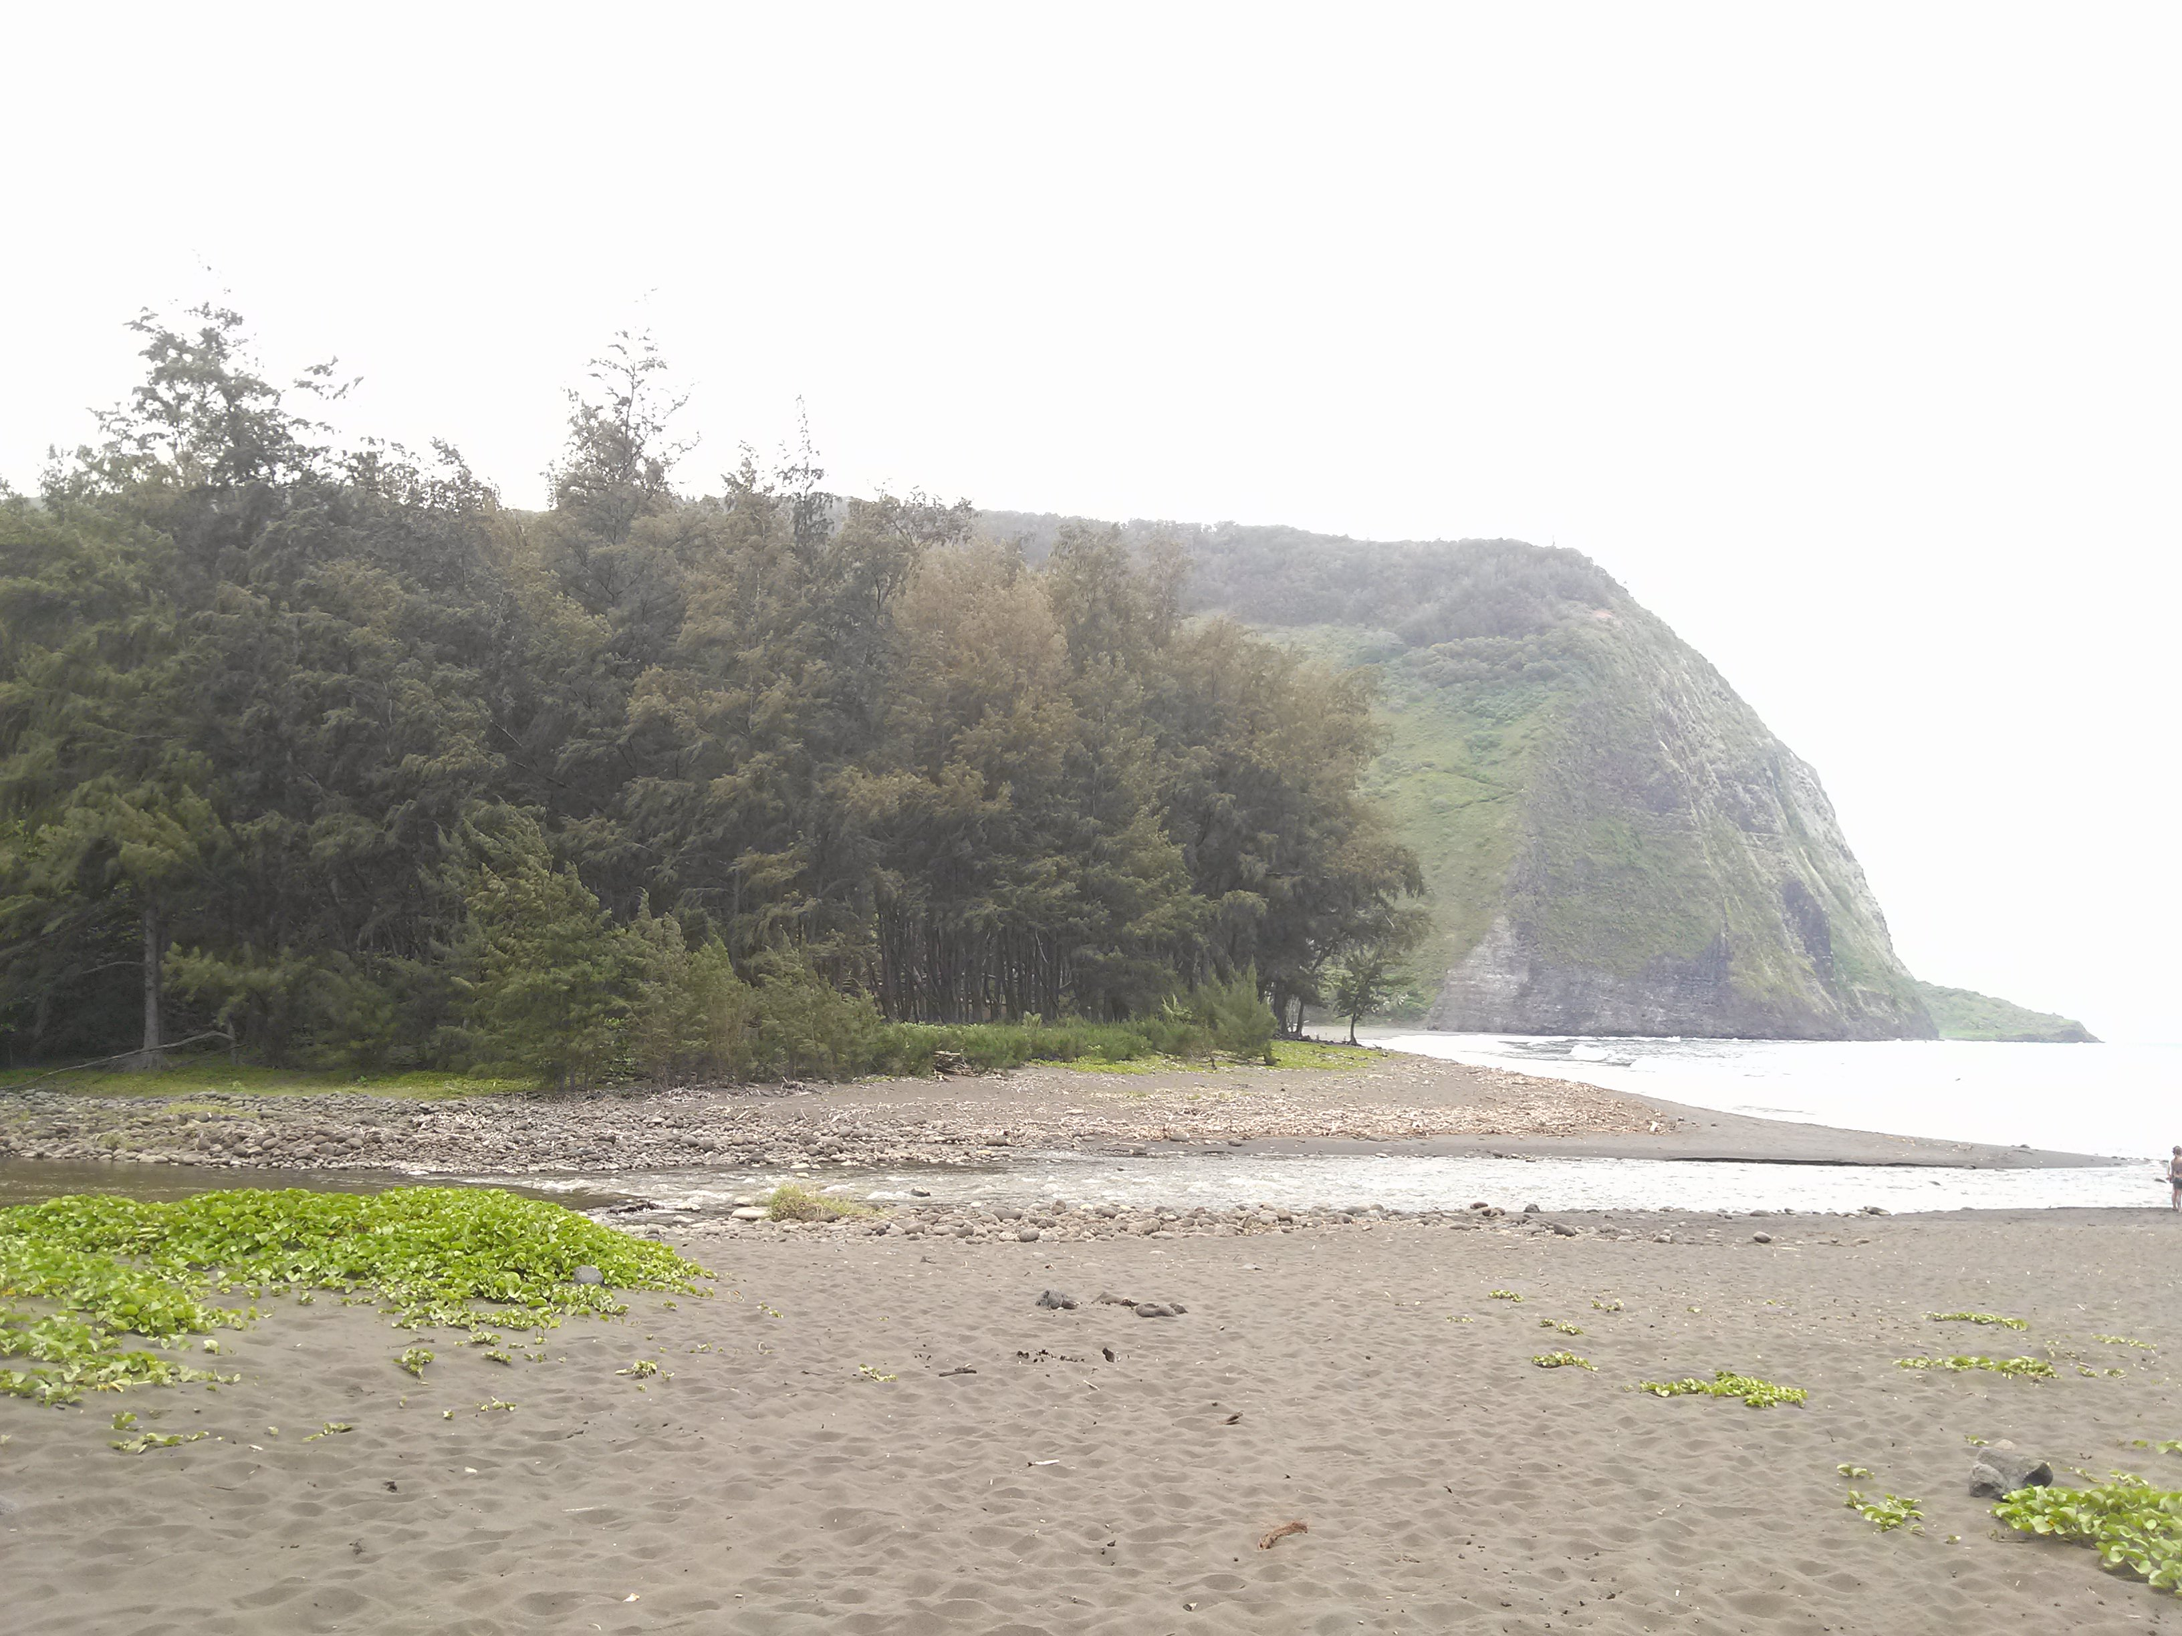
Waipio Muliʻwai

Slide 20
Waipi`o Paka`alana
Aia i Waipi`o Pâka`alana e
Paepae kapu `ia o Lïloa e
He aloha ka wahine pi`i i ka pali
Pû`ili ana i ka hua `ûlei
I ka `ai mo`a i ka lau lâ`au
Ho`ola`au mai o Kawelowelo
**Ua pe`e pâ Kaiâulu o Waimea
E ola o Kukeolo`ewa e
There at Waipi`o is Pâka`alana
And the sacred platform of Lïloa
Beloved is the woman who ascended the hill
With armfulls of `ûlei boughs
Her food cooked with the branches of the trees
She for whom Kawelowelo always longed
Hidden from the stinging Kaiâulu of Waimea
And long may Kukeolo`ewa still live
This ancient chant is a mele inoa for Kamehameha Nui. Waipi`o is a valley is the seat of government of Liloa, ancient king of Hawai`i, the father of Umi. Paka`alana was the temple and residence of King Liloa.
Verse 1, paepae was the doorsill of the temple, held in high esteem, for it represented all of the building.
Verse 2, wahine pi`i ka pali is from the legend of Haina-kolo, a Hawaiian chiefess who married her cousin, a king of Kukulu-o-Kahiki, was deserted by him, swam back to Hawai`i with her small child and arrived at Waipi`o in a state of hunger.
Verse 3, She climbed the cliffs and ate of the `ûlei berries without offering the deity of Waipio a sacrifice; a great offense. As punishment she became distraught and wandered away into the wilderness of Waimanu. After a long search her husband found and repented for her. With kind consideration, she regained her understanding and her family was happily re-united.
Verse 4. Kai-a-ulu is a fierce rain squall that arises suddenly in the uplands of Waimea. For protection, one crouches (pe`e) behind grass or hastily builds a shelter. Kukeolo`ewa was an evil demon.

Slide 21
Pakaʻalana
A prominent Ancestral Ohana “Family” History and story of ʻUmi, son of Lïloa. On a walk on the Alanui O HaʻMakua “The wide Path of the Breath of God” Lïloa journeyed onto the ahupuaʻa of Pauʻ̈uilo. At a cross road to Umikoa he meets a beautiful woman, Akahi. They spend the night together and conceive a child. Lïloa tells Akahi that if she has a son, to name him ʻUmi. Before departing, he leaves behind his malo, a whale tooth necklace and his war club as tokens to the unborn child. As time has passed Umi is born. When he becomes a young man, Akahi tells him of his true heritage and tells him to go to his father in Waipiʻo Valley. She gives ʻUmi the gifts Lïloa left and instructs him that upon meeting his father, to sit on his father’s lap and tell him who he is. ʻUmi becomes the favored son and Hakau, Lïloa’s other son is enraged with jealousy. Upon Lïloa’s death, Hakau inherits the land, but ʻUmi is placed in charge of the gods and the temples. Hakau poorly treats ʻUmi which drives him to leave Waipiʻo Valley. Hakau extends this mistreatment to the people of Waipiʻo, and ʻUmi, upon hearing this, returns to attack Hakau and kills him. Umi then assumes Hakau’s position as the High Chief.

Slide 22
Waimanu Valley

Slide 23
Sites of Waipio

Slide 24
Elemental Wisdom of Hawaii
Tour Packages
Kumulipo: Origin of Life
Kumulipo (kumu li po or kumu uli po) is a Hawaiian word, which can be translated as beginning in darkness or source of life or basis of existence. The old Hawaiian chant called Kumulipo describes the creation of the world, and the relationships between humans and other life. Kumulipo is a story of the lipo (dark depths) of the past to the lipo of the future. The chant describes the origin of the islands, the dawn of life and the birth of the first humans.
Papakū Makawalu: The methodical holistic preview of the Hawaiian Universe.
Papahulilani:
Is the space from above the head to where the stars of the Universe sit.
Papahulihonua:
The inclusive parts of our body with relation to the earth and ocean.
Papahānaumoku:
The embryonic path of all life forces that leads into the eternal journey.

Slide 25
Aloha and Mahalo Nui!
Kahea Design LLC

